Slide 1
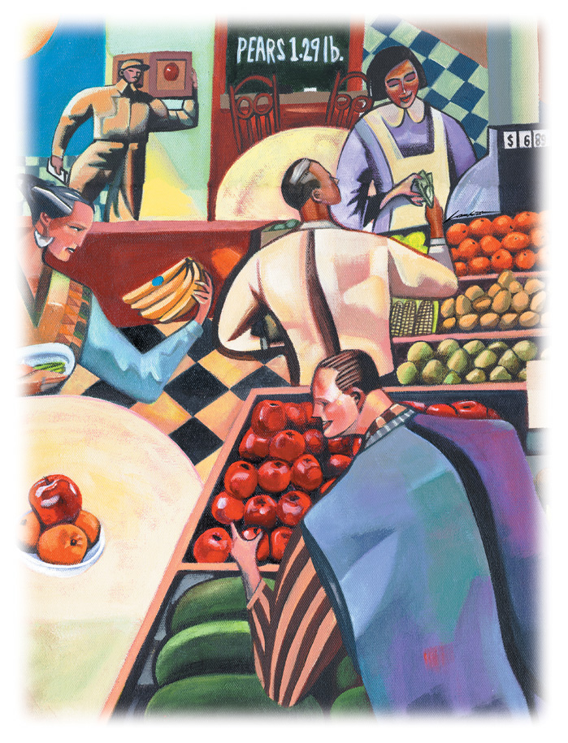
Lecture 1
Economics & Its Ten Principles

Slide 2
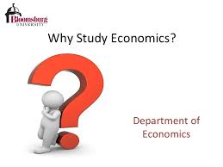

Slide 3


Slide 4
ECONOMICS
The word economy comes from the Greek word oikonomos, which means “one who manages a household.”
Economics is the study of how society manages its scarce resources in alternative ways to meet unlimited wants.
When wants exceed the resources available to satisfy them, there is scarcity. The condition that arises because the available resources are insufficient to satisfy wants.
Faced with scarcity, people must make choices. Choosing more of one thing means having less of something else.

Slide 5
ECONOMICS
The opportunity cost of any action is the best alternative forgone.
So the study of economics concerned with the problem of choice — the reality we are confronted with as a result of our scarce resources compared with our unlimited wants.
Economics, therefore, deals with those aspects of human behavior which arises from the scarcity of means to achieve a given end.

Slide 6

Ten Principles of Economics

Slide 7
HOW PEOPLE MAKE DECISIONS
We start the study of economics with four principles which help us to understand how individual make decision :
People face tradeoffs
The cost of something is what you give up to get it (opportunity cost).
Rational people think at the margin.
People respond to incentives.

Slide 8
Principle 1: People Face Tradeoffs
“There is no such thing as a free lunch”
To get something that we like, we usually have to give up something that we also like.
For example-
A student and her time:
Studying vs. Watching TV.
Society’s tradeoffs:
Guns vs. Butter
Clean environment vs. higher income

Slide 9
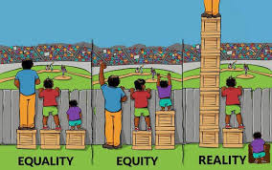
Principle 1: People Face Tradeoffs
Society’s tradeoffs (cont’d):
Efficiency vs. Equity
Equity means that the benefits of those resources are distributed fairly among society’s members.
Efficiency means that society is getting the most it can from its scarce resources.

Slide 10
Principle 2: The Cost of Something is what You Give Up
Making decisions requires comparing the costs and benefits of alternative courses of actions.
For example
Decision to go to university.
What are the benefits and costs of attending class?
Opportunity cost: Opportunity cost is the second best alternative foregone to obtain something.

Slide 11
Principle 3: Rational People Think at the Margin
Rational people systematically do the best they can to achieve their objectives, given the opportunities they have.
Firms decide how many workers to hire and how much of their product to manufacture and sell to maximize profits.
Consumers decide a bundle of goods that gives the highest possible level of satisfaction.
Economists use the term marginal changes to describe small incremental adjustments to an existing plan of action.

Slide 12
Principle 3: Rational People Think at the Margin
Individuals and firms can make better decisions by thinking at the margin.
Rational people often make decisions by comparing the marginal benefits (MB) with the associated marginal costs (MC).
Example
Airline pricing.
When Average Cost of each seat is $500. Should the airline sell the ticket $300 to a standby passenger?
As long as the standby passenger pays more than the marginal cost, selling the ticket is profitable.

Slide 13
Principle 3: Rational People Think at the Margin
There is a classic question: Why is water so cheap, while diamonds are so expensive?
The answer is that a person’s willingness to pay for any good is based on the marginal benefit that an extra unit of the good would yield.
The marginal benefit in turn depends on how many units a person already has.
That’s why the marginal value of a $ is different to a rich and to a poor.

Slide 14
Principle 4: People Respond to Incentive
An incentive is something that induces a person to act.
Marginal changes in costs or benefits motivate people to respond.
When the price of apples rises……….
Public policy makers should never forget about incentives because many policy changes the marginal costs or benefits that people face and so alter their behavior.
When policymakers fail to consider how their policies affect incentives, they can end up with results that they did not intend.
For example - Auto safety.

Slide 15
HOW PEOPLE INTERACT
The first four principles discussed how individuals make decisions.
The next three principles concern how people interact with one another.
Trade can Make Everyone Better Off
Markets are Usually a Good Way to Organize Economic Activity
Governments can Sometimes Improve Market Outcomes

Slide 16
Principle 5: Trade can Make Everyone Better Off
Trade between two countries or two person is not a zero sum game in which one side wins and the other side loses.
Rather trade between two parties can make each party better off which we will discuss in chapter 2.
People gain much from their ability to trade with one another.
Trade allows people to specialize in what they do best and to enjoy a greater variety of goods and services.

Slide 17
Principle 6: Markets are Usually a Good Way to Organize Economic Activity
Communism vs. Market Economy.
Communism: An economy that allocates scare resources through the centralized decisions of the government. These central planners decided what goods and services were produced, how much was produced, and who produced and consumed these goods and services.
Market economy: An economy that allocates resources through the decentralized decisions of many firms and households as they interact in markets, where prices and self-interest guide their decision for goods and services.
In market economy, firms decide whom to hire and what to make, households decide which firms to work for and what to buy with their incomes.

Slide 18
Principle 6: Markets are Usually a Good Way to Organize Economic Activity
At first glance, the success of market economies is puzzling.
In a market economy, no one is looking out for the economic well-being of society as a whole.
Yet market economy have proven remarkably successful in organizing economic activities in a way that promotes overall economic well-being.
Adam Smith made the observation that when households and firms interact in markets guided by the invisible hand, they will produce the most surpluses for the economy.

Slide 19
Principle 7: Governments can Sometimes Improve Market Outcomes
If the invisible hand of the market is so great, why do we need government?
One reason we need government is that the invisible hand can work only if property rights are enforced.
Although markets are often a good way to organize economic activity, this rule has some important exceptions.
There are two broad reasons for a government to intervene in the economy: to promote efficiency and to promote equity.

Slide 20
Principle 7: Governments can Sometimes Improve Market Outcomes
To promote Efficiency…
Market does not provide best outcome when there exists Market Failure.
Market failure refers to a situation in which the market on its own fails to produce an efficient allocation of resources.
Possible causes of market failure are
Market Power
Externality
Asymmetric Information

Slide 21
Principle 7: Governments can Sometimes Improve Market Outcomes
To promote Equity…
Again a market economy rewards people according to their ability to produce things.
The invisible hand does not ensure that everyone has sufficient food, decent clothing, and adequate healthcare.
Many public policies, such as the income tax and the welfare system, aim to achieve a more equitable distribution of economic well-being.

Slide 22
HOW THE ECONOMY AS A WHOLE WORKS
The last three principles concern the workings of the economy as a whole.
A Country’s Standard of Living Depends on its Ability to Produce Goods and Services
Prices Rise when the Government Prints Too Much Money
Society Faces a Short-Run Tradeoff Between Inflation and Unemployment.

Slide 23
Principle 8: A Country’s Standard of Living Depends on its Ability to Produce Goods and Services
Citizens of high-income countries enjoy a higher standard of living - they enjoy more TV sets, more cars, better nutrition, better healthcare, and a longer life expectancy than citizens of low-income countries.
What explains these large differences in living standards among countries and over time?
Differences in standard of living between countries is attributable to differences in countries’ productivity.
Productivity: The amount of goods and services produced from each hour of a worker’s time.

Slide 24
Principle 8: A Country’s Standard of Living Depends on its Ability to Produce Goods and Services
The relationship between productivity and living standards also has profound implications for public policy.
When thinking about how any policy will affect living standards, the key question is how it will affect our ability to produce goods and services.
To boost living standards, policymakers need to raise productivity by ensuring that workers are well educated, have the tools needed to produce goods and services, and have access to the best available technology.

Slide 25
Principle 9: Prices Rise when the Government Prints Too Much Money
In Germany…
In January 1921, a daily newspaper cost 0.30 marks.
In November 1922, the same paper cost 70 million marks.
Inflation: An increase in the overall level of prices in the economy.
Because high inflation imposes various costs on society, keeping inflation at a low level is a goal of economic policymakers around the world.
But what does cause inflation?

Slide 26
Principle 9: Prices Rise when the Government Prints Too Much Money
One cause of inflation is the growth in the quantity of money.
When the government creates large quantities of money, the value of the money falls.
In Germany in the early 1920s, when prices were on average tripling every month, the quantity of money was also tripling every month.

Slide 27
Principle 10: Society Faces a Short-run Tradeoff between Inflation and Unemployment
Increasing the amount of money in the economy stimulates the overall level of spending and thus the demand for goods and services.
Higher demand may over time cause firms to raise their prices, but in the meantime, it also encourages them to increase the quantity of goods and services they produce and to hire more workers to produce those goods and services.
And more hiring means lower unemployment.
This line of reasoning leads to one final economy wide trade-off: a short-run trade-off between inflation and unemployment.

Slide 28
Summary
In making decision people always face trade-off.
Each decision involves opportunity cost.
Incentives alter people’s decisions.
In making decision individual compare marginal benefits to marginal costs.
Trade is not a zero-sum game
Markets are usually a good way of coordinating trade among people.

Slide 29
Summary
Government can potentially improve market outcomes if there is some market failure or if the market outcome is inequitable.
Productivity is the ultimate source of living standards.
Money growth is the ultimate source of inflation.
Society faces a short-run tradeoff between inflation and unemployment.

Slide 30
What we have learnt…..?
What is economics?
How do people make decisions?
How do people interact with one another?
How do the economy as a whole works?
Some basic terms
Scarcity
Opportunity cost
Market economy
Communism
Property rights and market failure.
Externality and market power.
Productivity
Inflation

Slide 31
Readings
N. G. Mankiw- Principles of Microeconomica, 3rd Edition

Slide 32


Slide 33
The End

